Slide 1
The Recommendations of the Commission on Evidence-Based Policymaking
ds
Presented to the Advisory Committee on Data for Evidence Building
October 23, 2020
Lucas Hitt, U.S Dept. of Commerce

Slide 2
What was the Commission?
The Commission was the result of discussions on opportunities for better creating and using evidence to inform decision-making, whether in budget decisions or day-to-day management, especially by:
  addressing barriers to the reuse of already collected data
  Identifying strategies for building into program design
Created by legislation co-sponsored by Speaker Paul Ryan and Senator Patty Murray, enacted March 30, 2016 (P.L. 114-140)
Members appointed by the President, Speaker of the House, House Minority Leader, and the Senate Majority and Minority Leaders – 1/3 on privacy; 2/3 experts on program administration, data, or research
Provided its report to the President and the Congress on September 7, 2017

Slide 3
The Commission’s Process
The Commission engaged in an 8-month fact-finding process to gather input:
    7 Public Meetings with 49 invited witnesses
    3 Public Hearings in DC, Chicago, and San Francisco with 37 witnesses
    Request for Comments in the Federal Register with more than 350 submitted comments
    CEP Survey of 209 Federal offices
    More than 40 meetings with other groups
Following public input, the Commission ran a deliberative review process to consider all of the input received and distilled areas of agreement into the Commission’s 22 recommendations

Slide 4
The Report – Major Themes
Improved Access to Data – Laws and policies are not currently optimized to support the use of data across programs or to maximize privacy
Stronger Privacy Protections – protections today are applied unevenly across government, and not dynamic enough to meet the changing risks associated with the use of data
Greater Capacity – filling the existing capacity gaps across institutions and actors inside and outside government, including
  better coordination of existing actors into a coherent evidence community
  the establishment of an entity to better support access and privacy

Slide 5
The Commission’s Vision
A future in which
  rigorous evidence is created efficiently,
  as a routine part of government operations, and
  Used to construct effective public policy.

Slide 6
Recommendations to Improve Secure, Private, and Confidential Data Access
  Establish a National Secure Data Service to facilitate access to data for evidence building while ensuring privacy and transparency in how those data are used.
  Require stringent privacy qualifications for acquiring and combining data for statistical purposes at the NSDS.
  Review and revise laws authorizing Federal data collection and use to ensure that limited access to administrative and survey data are possible under strict privacy controls.
  Develop a uniform process for external researchers to apply and qualify for secure access to confidential government data for evidence-building purposes.

Slide 7
Recommendations Related to State-Collected Administrative Data
  Ensure that state-collected administrative data on quarterly earning are available for statistical purposes only and made available through a single Federal source.
  Direct Federal departments that acquire state-collected administrative data to make the data available for statistical purposes. Where there is substantial Federal investment in a program, Federal departments should, consistent with applicable laws, direct states to provide the data necessary to support evidence building.

Slide 8
Recommendations to Modernize Data Protections for Evidence Building
  Require comprehensive risk assessments on de-identified confidential data intended for public release to improve how data are protected and risk is managed
  Adopt modern privacy-enhancing technologies for confidential data used for evidence building to ensure the government’s capabilities to keep data secure and protect confidentiality are constantly improving
  Assign senior officials responsibilities for data access and data stewardship within government departments
  Codify policies for maintaining integrity and objectivity in Federal statistics to promote continued trust in the accuracy of information being used to guide government decision making

Slide 9
Recommendations to Strengthen Federal Capacity for Evidence Building
  Identify or establish a Chief Evaluation Officer in each department to coordinate evaluation and policy research and to collaborate with other evidence-building functions within Federal departments.
  Develop learning agendas in Federal departments to support the generation and use of evidence to address the range of policymakers’ questions.
  Improve coordination of government-wide evidence building by directing OMB to facilitate cross-government coordination.
  Align administrative processes with evidence-building activities, including those related to the approval of information collections and the procurement of services for evidence building.
  Ensure that sufficient resources are available to support evidence-building activities, including resources to support implementation of the recommendations of the Commission.

Slide 10
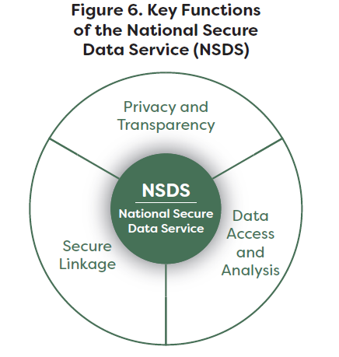
Functions of CEP’s NSDS

Slide 11
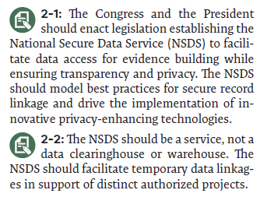
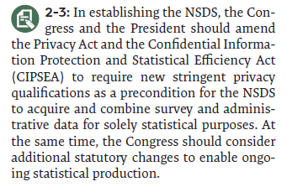
The National Secure Data Service

Slide 12
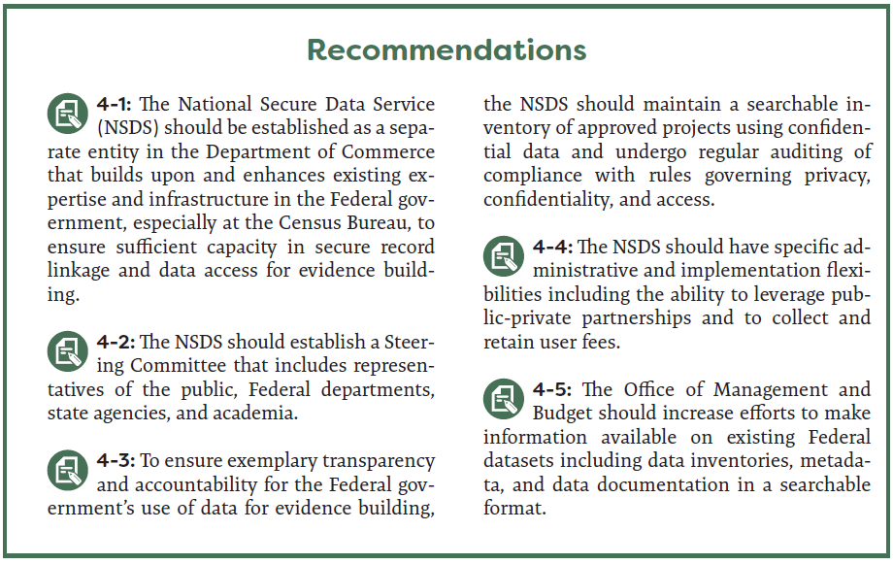
The National Secure Data Service

Slide 13
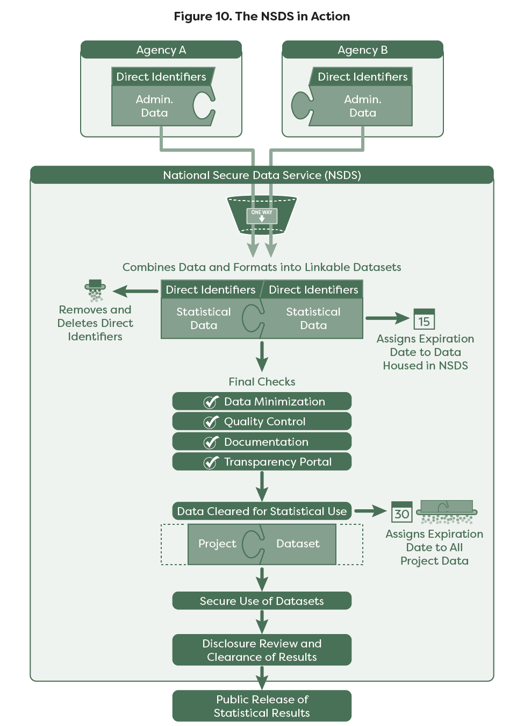
CEP’s NSDS at Work…

Slide 14
The Commission’s Report
Available at www.cep.gov

