Slide 1
The Use of Data for Evidence-making: International Lessons Learned
Julia Lane
NYU and Coleridge Initiative

Slide 2
Outline
United Kingdom
Germany
New Zealand
Summary
Focus will be on context, structure, achievements, lessons learned

Slide 3
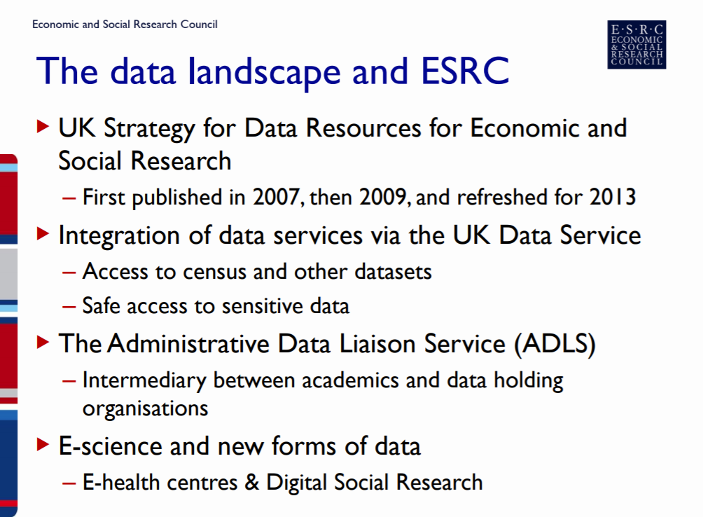
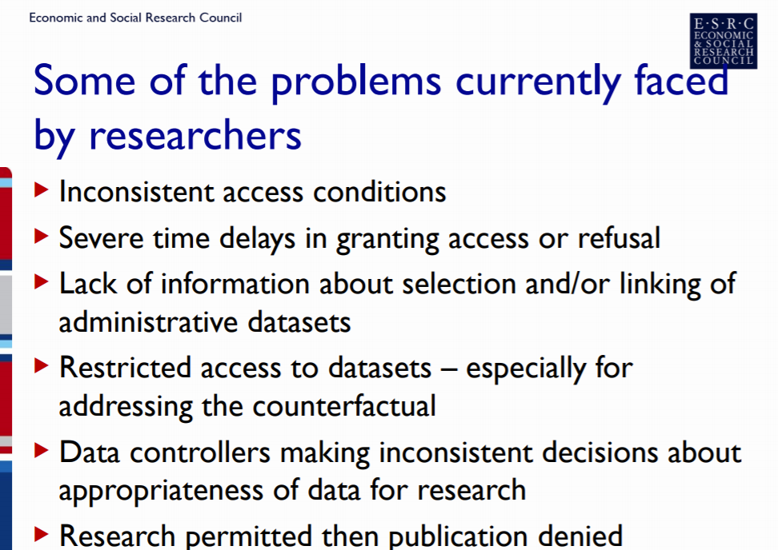
United Kingdom: Initial Context

Slide 4
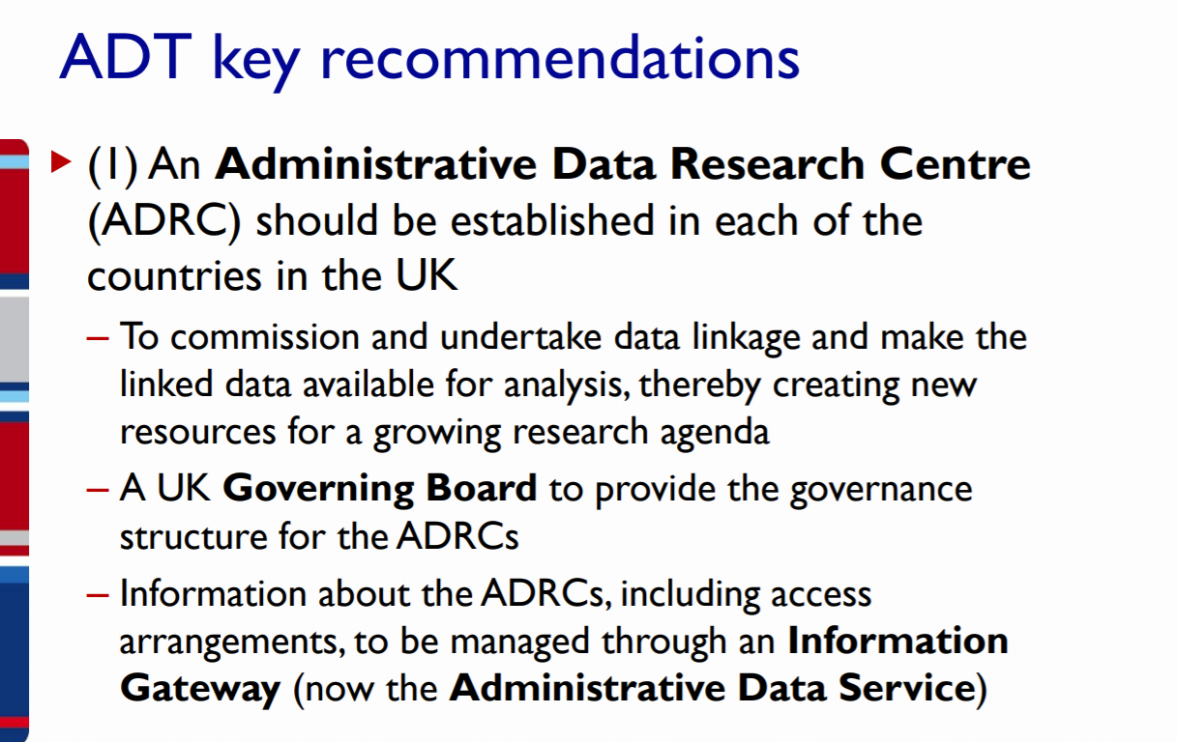
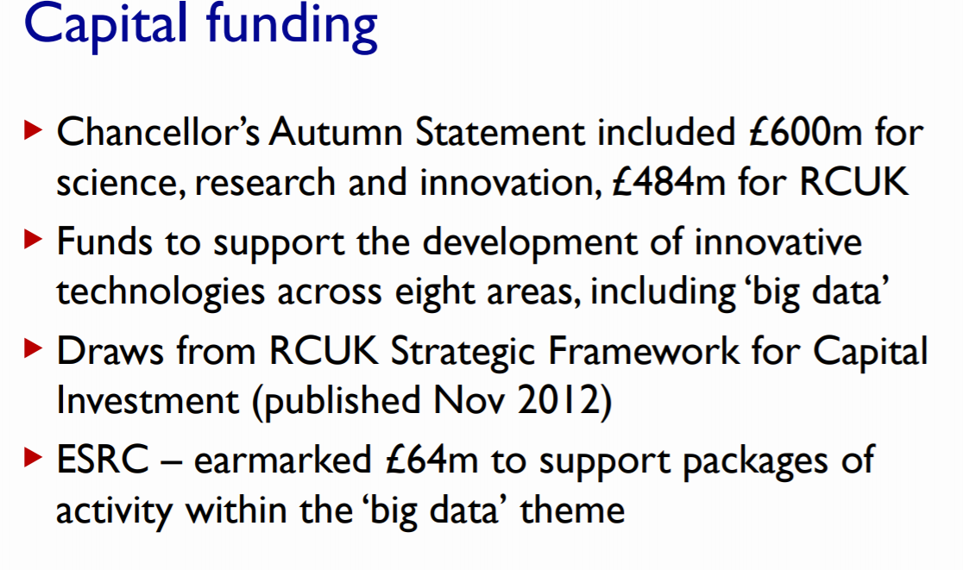
Recommendations and Funding
Current budget: £55m

Slide 5
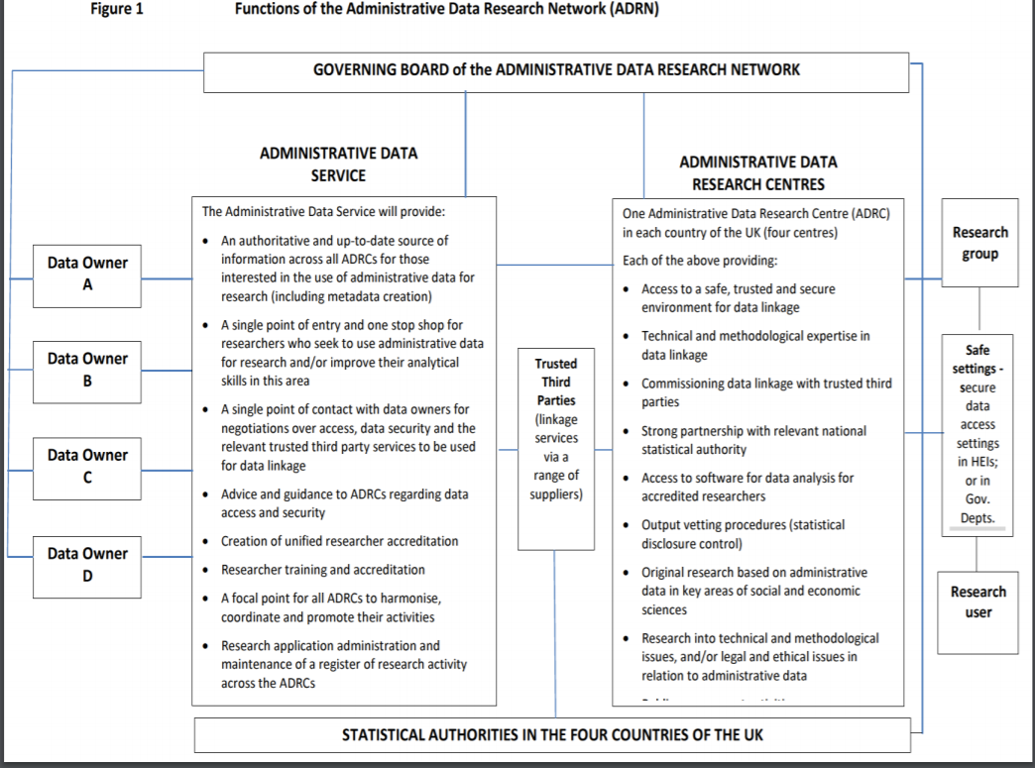
Organizational Structure

Slide 6
Achievements
Achievements
New safe access facilities
Networks of researchers
Value to society –“However, with the limited number of projects currently being facilitated at the ADRN, the ongoing running costs may not be regarded as value for money.” (Elias, 2017). 2018 review of the ADRN concluded that the English part of the consortium was not working. problems between the academics running it, the Office for National Statistics, the NHS (health) and HMRC (tax, revenues).
Ability to Pivot: ADR (Wales), ADR (Scotland) and ADR (Northern Ireland) were working well, primarily because of more trust between statistical agencies and researchers in the devolved administrations. All the money that had gone to ADR (E) was handed over to the Office for National Statistics so that they could develop data sharing with the academic community. There is still a national coordinating body, but very small and concerned with strategic direction of the four bodies. It has been renamed the Administrative Data Research UK https://esrc.ukri.org/research/our-research/administrative-data-research-uk/.

Slide 7
Revised funding and success
£59m, most of which is being spent in the period July 2018 to July 2021.
The money comes from what is called the National Productivity Fund and is all channelled through UKRI (the umbrella org for the seven research councils).
Each of the academic centres get a substantial chunk.
Funding for national and devolved agencies: Office for National Statistics; Ministry of Justice, Scottish Government, Welsh Government, Northern Ireland Statistic and Research Agency.
One of the biggest success stories is the ONS/MoJ/HMRC/DSS linkage for offenders (see https://www.gov.uk/government/publications/uk-national-data-strategy/national-data-strategy#contents see ‘Data First’ – there are plenty of other examples in this document .

Slide 8
Lessons
Foster trust relationships between data controllers and the academic community – this takes a lot of time and effort
Need strong leadership
Put money where the power lies
Use appropriate legislation to the hilt (without annoying everyone in the process!)
Be prepared to sacrifice what you thought were good ideas in the face of evidence that they are not working well
Engage with the public – let them know how their data are being used, why and how safe they are kept

Slide 9
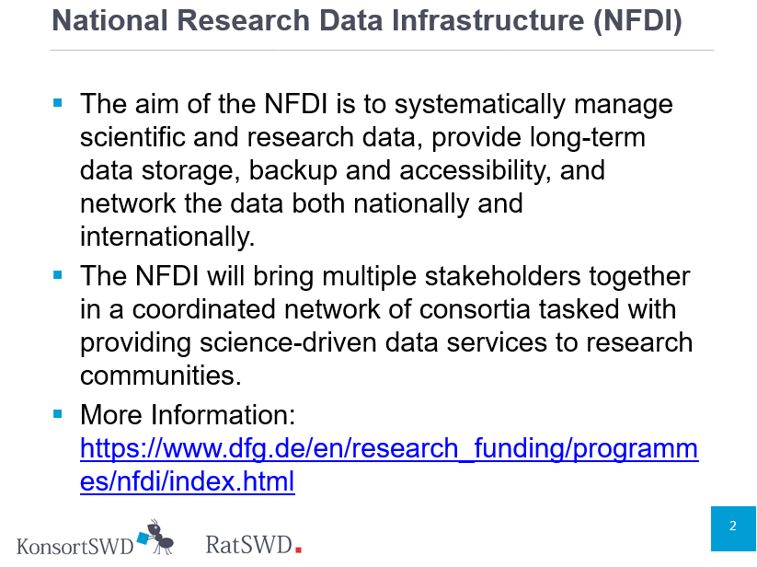
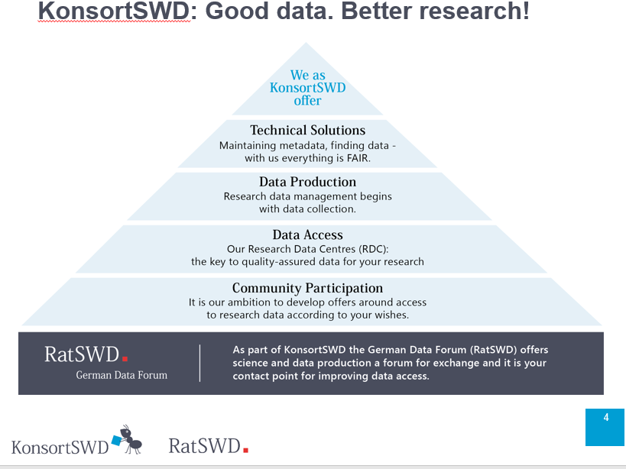
Germany: Context

Slide 10
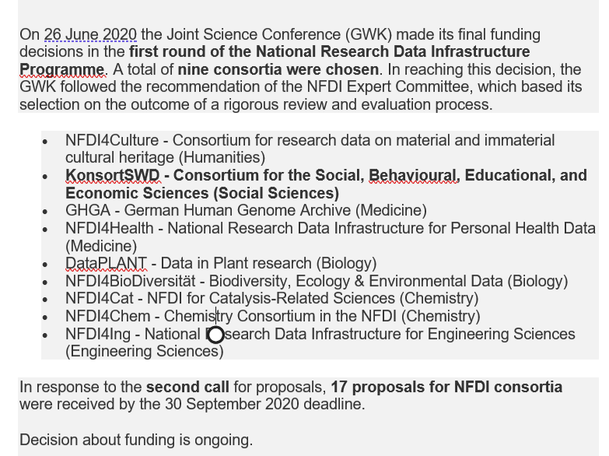
Funding

Slide 11
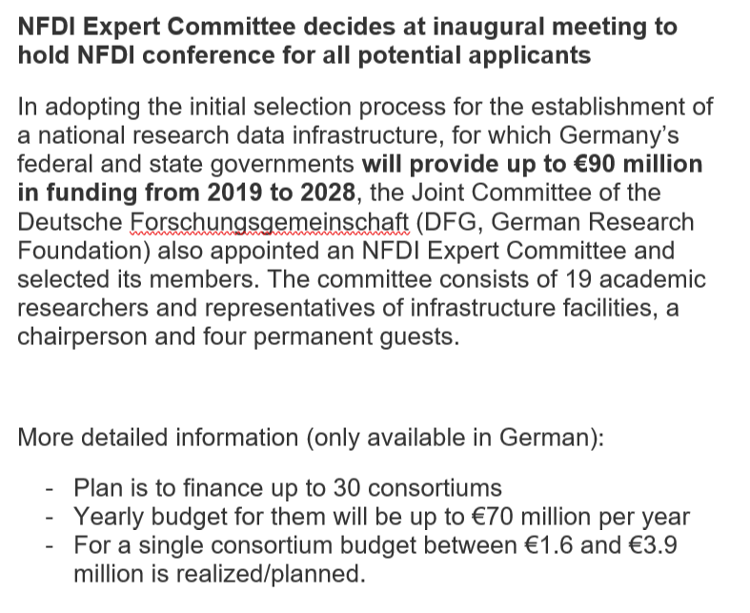
Funding

Slide 12
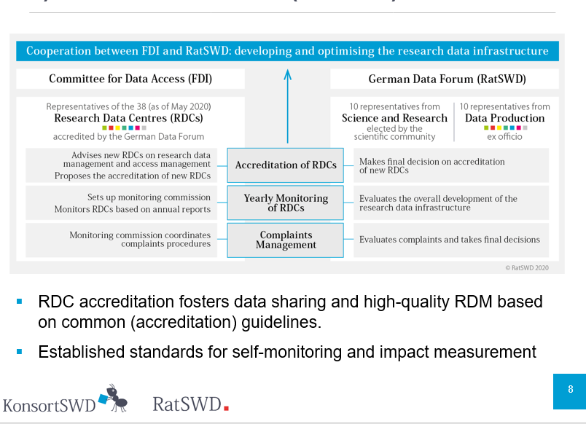
Organizational Structure

Slide 13
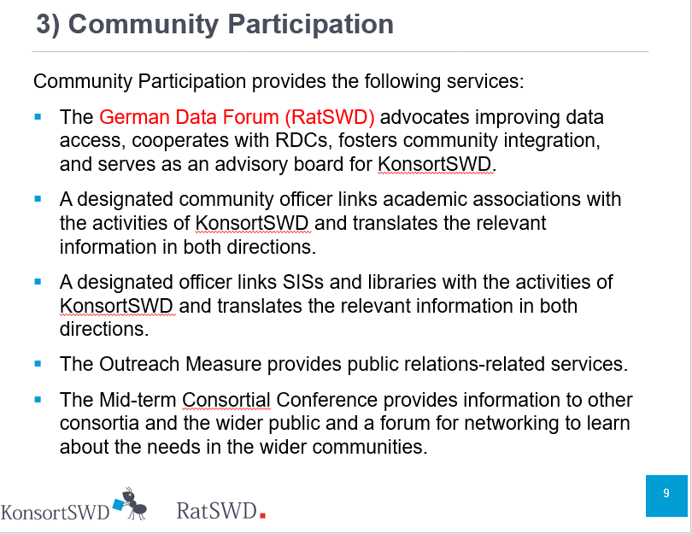
Organizational Infrastructure

Slide 14
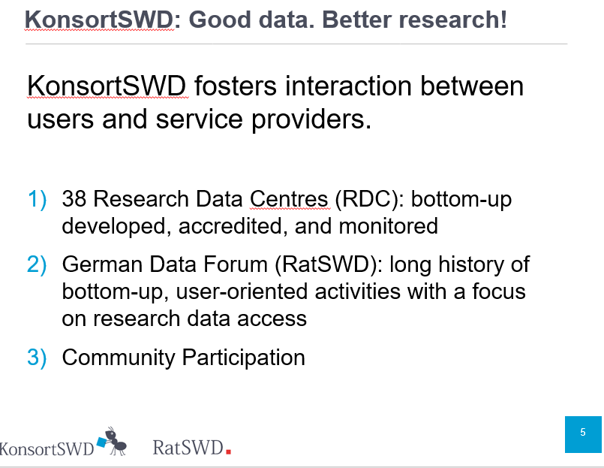
Achievements

Slide 15
Lessons
Lessons Learned
Community Input
Data trust
Data search and discovery
Cultural Infrastructure: incentives and capability
Other points
Main idea to strengthen data infrastructure across all fields
Process is given to the research community (scientific transparent decision process)

Slide 16
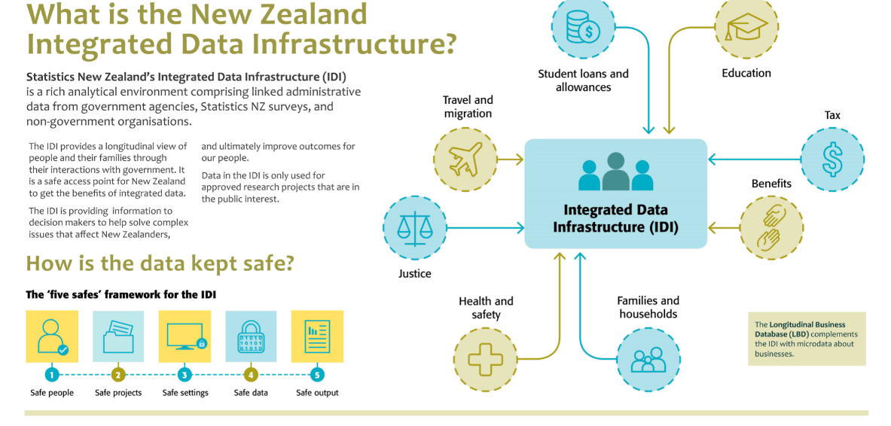
New Zealand: Context

Slide 17
Social investment
The New Zealand experience
Sir Bill English (former NZ PM)

Slide 18

Creating a system that learns
We need to know what works, for whom, at what cost.

Slide 19


The New Zealand context
Health
NZ Super
Social security and welfare
Education
Other
Core Governmentservices
Finance costs
Transport and communication
Law and order
Defence
Budget 2018
Budget 2018

Slide 20


What do we mean by integrated data?
1 | 2 | 3 | 4 | 5 | 6 | 7 | 8 | 9 | 10 | 11 | 12 | 13 | 14 | 15 | 16 | 17 | 18 | 19
^{Aged}
^{CYFS}
^{Abuse Findings}
^{Care}
^{Education}
^{Youth Justice}
^{Income support}
^{Total cumulative paid ($1000)}
 |  | 6 |  |  |  | 18 |  |  | 37 |  |  | 53 | 58 | 71 | 120 | 126 | 127 | 142

Slide 21
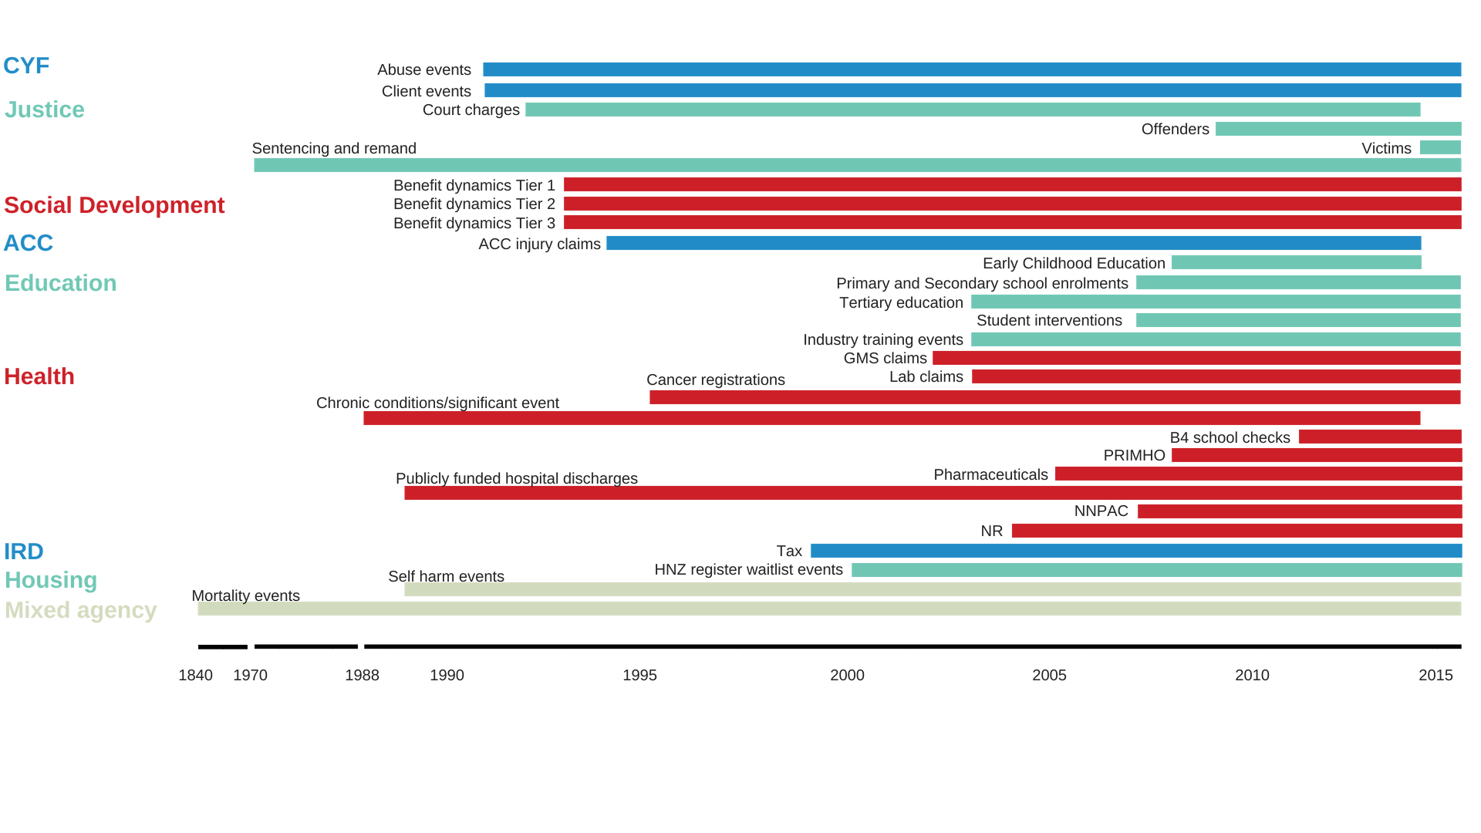
The Integrated Data Infrastructure (IDI)

Slide 22
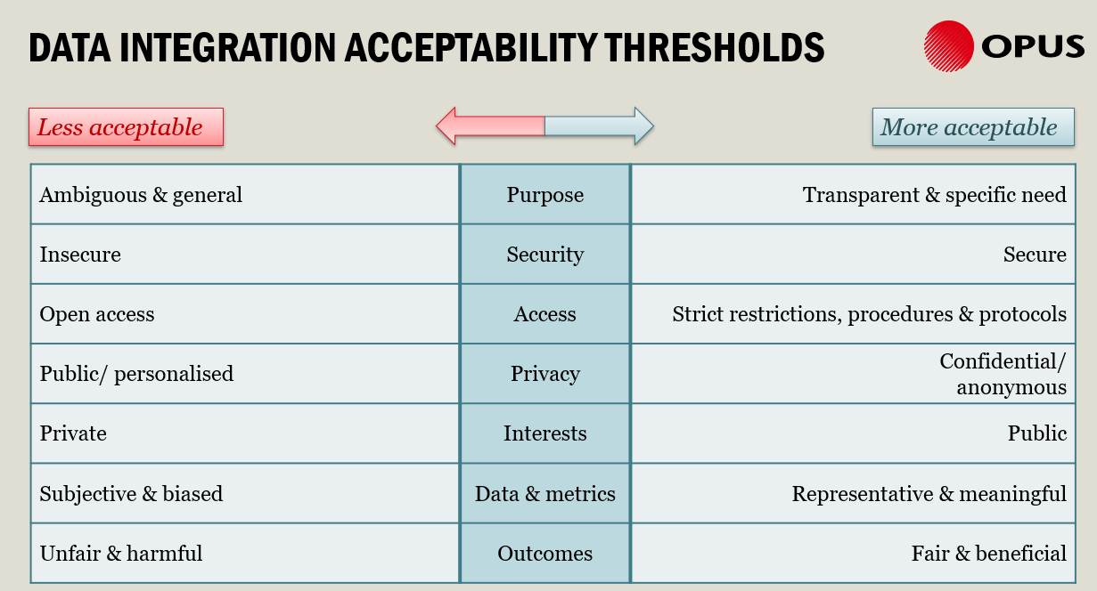
New Zealand: Context

Slide 23
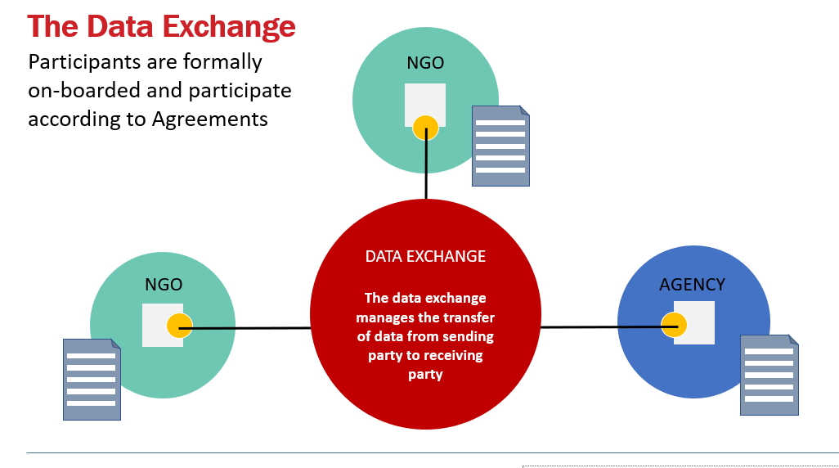
Organizational Structure

Slide 24
Achievements: Valuing the welfare system
Level I: Aggregate liability valuation Actuarially estimated liability for social welfare benefits Incorporate macroeconomic trends, policy changes, trends in experience and financial impacts of level III initiatives
Level II: Cohort liability estimates and KPIs
Apportion aggregate liability from Level I to statistically determined cohort groups
Set targets and monitor KPIs and liability by cohorts
Level III: Client level analytics (statistical modelling) Evaluate impact of initiatives Translate individual impacts to estimates of cohort liability

Slide 25
Aggregate liability valuation
Total liability
72.2 billion
$13.7 billion​
Increase due to policy package to reduce child poverty – because of the method we employ, this can be isolated
Liability decrease related to experience, $billions
Liability reduction
attributable to system reform
Updated model assumptions
Client numbers

Slide 26

Cohort liability estimates
Of that $72.2 billion, 75% is attributable to clients who entered the benefit system under the age of 20.
      High-liability cohorts include:
        Sole parents
        People who churn in and out of the benefit system
        Ex-prisoners on release
        Young people with disabilities or chronic conditions, who want to work but need support to do so.

Slide 27
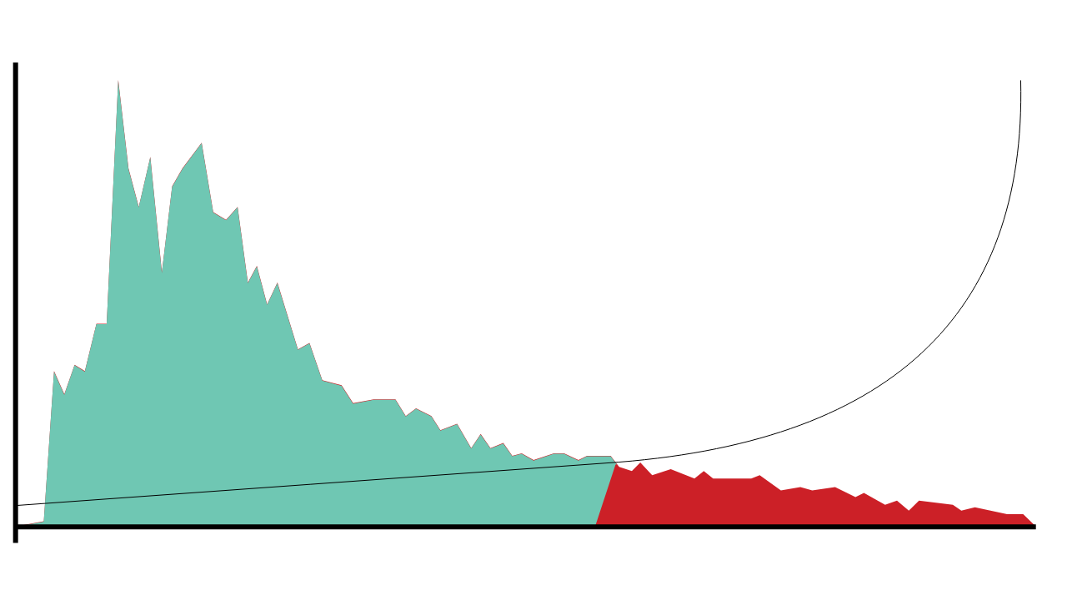

Understanding risk
The risk profile of this cohort reveals a long tail of increased risk.
2,500
The hypothetical cost effectiveness of interventions increases when they are delivered to the students who need them most.
48,077 low-risk students have an average risk of 27%
Number of students
1,250
6,990 high risk students have an average risk of 76%
0
0%
100%
Risk of not achieving NCEA2 by age 18

Slide 28

Reducing social harm from crime
Of the cohort born in 1978, the oldest generation for which full conviction data is available:
One in four people have a conviction
80%
One in three men have a conviction
of convictions went to individuals who were first convicted before the age of 20
One in two Maori or Pasifika men have a conviction

Slide 29
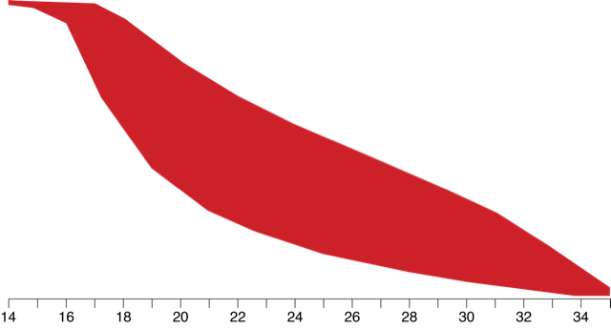
The data shows that desistance, not escalation, is the norm.
Criminal career finished
Most people stop offending quickly, and those who persist commit fewer offences over time.
Criminal career underway
Criminal career yet to start
Population: 10,000
Age

Slide 30
Seeing outside the silo
Integrated data generated insights into the relationship between traumatic brain injury and offending...
13% of the general population
36% of people charged in court
46% of people imprisoned
People charged in court who had a TBI were, on average,
3 years younger
at first charge
have a traumatic brain injury recorded in hospitalisation or ACC claims data.
Offenders with a recorded traumatic brain injury were more likely to have committed violent or sexual offences...
TBI
37%
38%
27%
No TBI
23%
35%
42%
… than offenders who had not.
Convicted for violent or sexual offence
Convicted for other offence
Not convicted

Slide 31
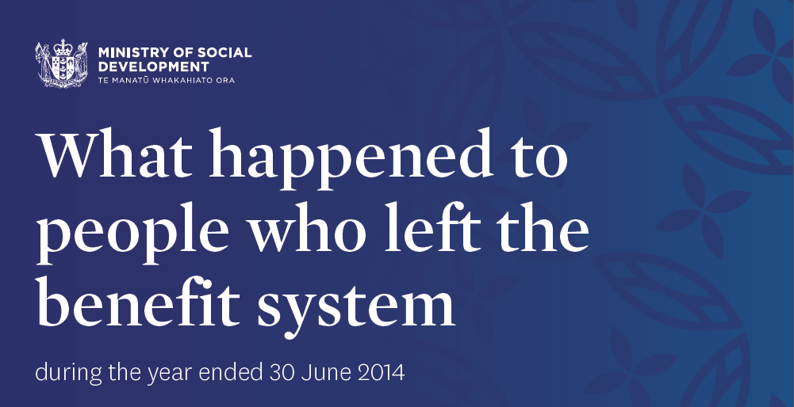

Lessons
Focus on value proposition “social investment”
IDI grew in response to ministry demand – “MSD only began using it about 3 or 4 years ago, and I’ll bet we’ve doubled our use in each of the last two years”
IDI survey links to admin data important
IDI analysis underpins many policy decisions in NZ
Workforce capacity gap is major constraint
Stats NZ compute capacity limited

Slide 32
Overall
Clear international successes and failures
Security necessary but not sufficient
Strong, trusted leadership
Value proposition is key
  Create value for agencies -
  Operational and implementable (timeliness often key)
  Analysis of outliers
  Analysis of small populations
  Analysis of regions and localities
Workforce capacity is critical
Long term investment necessary

Slide 33
Comments and questions
Julia.lane@coleridgeinitiative.org
Julia.lane@nyu.edu

