Slide 1

Current Issue: Offshore Profit Shifting
Ray Mataloni, Balance of Payments Division
BEA Advisory Committee Meeting
November 9, 2018

Slide 2
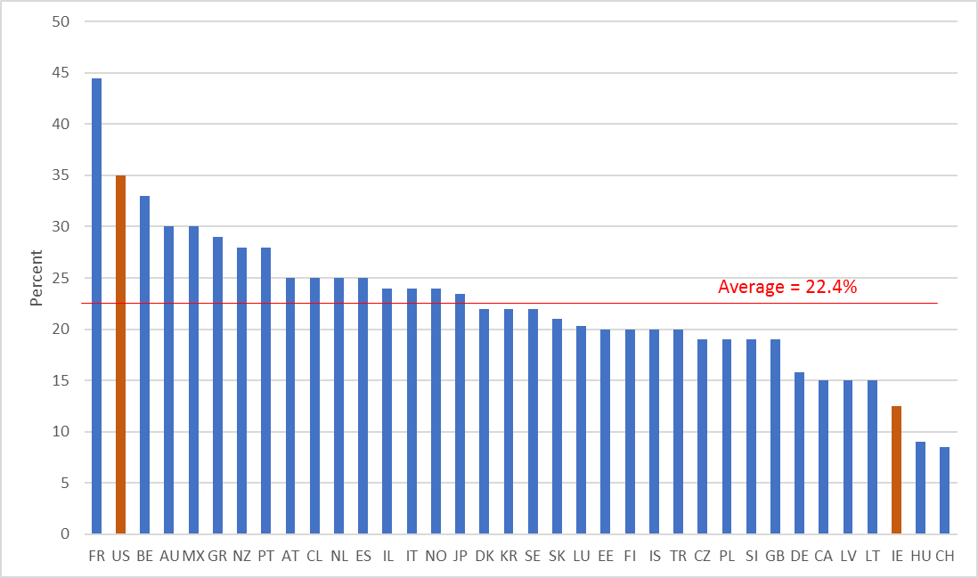


Statutory corporate tax rates, 2017
Source: OECD Tax Database (http://www.oecd.org/tax/tax-policy/tax-database.htm)

Slide 3
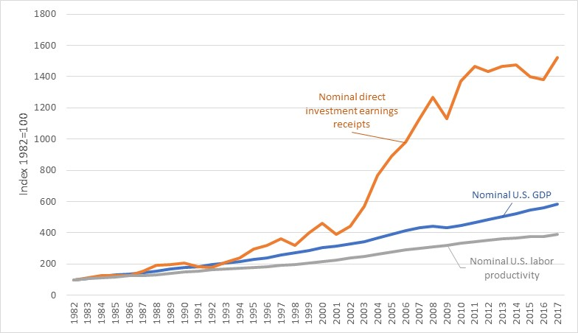
Rapid growth in DI earnings receipts

Slide 4
Other ACM presentations on globalization
Date | Topic
Nov 2016 | Trade in services initiative
Nov 2015 | New measures of the impact of globalization
 | New FDI data on greenfield and acquisitions
Nov 2014 | Factory-less goods manufacturing, global value added chains
May 2014 | The comprehensive restructuring of the international economic accounts
May 2013 | Trade in value added
May 2011 | Global manufacturing and measurement issues raised by the iPhone
Nov 2010 | Measurement issues arising from the growth of globalization
May 2009 | Measuring the rapidly changing economy – international aspects

Slide 5
Outline
How large is profit shifting?
  Formulary apportionment
Which accounts are affected by profit shifting?
  Applying formulary apportionment across the U.S. economic accounts
How do multinationals shift profits?
  Cost-sharing agreements

Slide 6
How large is profit shifting?
Research question: How is measured U.S. labor productivity affected by re-apportioning U.S. multinationals’ global profits across countries by the scale of their local factors of production?
Paper: Offshore Profit Shifting and Domestic Productivity Measurement
By Fatih Guvenen, Raymond Mataloni Jr., Dylan Rassier and Kim Ruhl

Slide 7






A hypothetical re-apportionment example
Under separate accounting
Under re-apportionment
$ = U.S. MNE measured profits from current production
= U.S. MNE factors of production

Slide 8
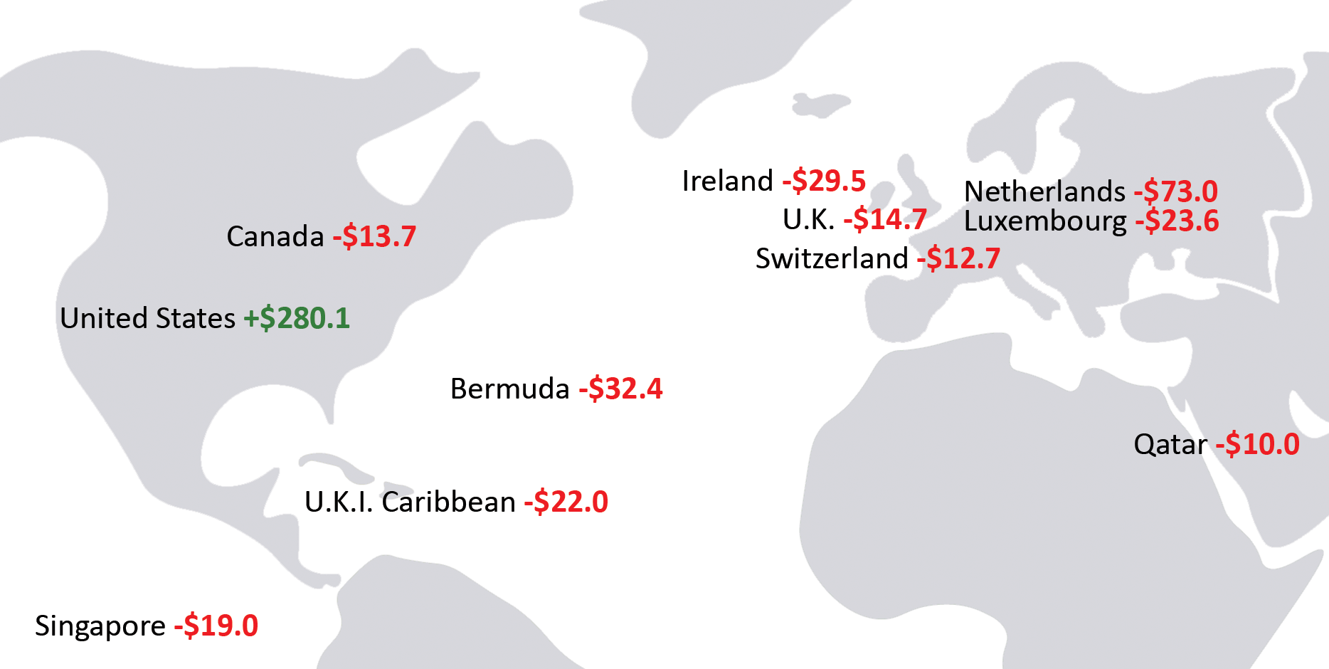
Re-apportionment of U.S. MNE global profits
2012 ($ billions)

Slide 9
Productivity results
Reduces, but does not eliminate, the slowdown in measured U.S. labor productivity

Slide 10
Which accounts are affected?
Research question: How do the results from the previous paper affect key published aggregates in the U.S. economic accounts?
Paper: Multinational Profit Shifting and Measures throughout Economic Accounts
By Jennifer Bruner, Dylan Rassier and Kim Ruhl

Slide 11
Some illustrative results for 2014
Under reapportionment …
Some profits currently recorded here
Consumption
GDP
+ Investment
+ Receipts of income (on direct and portfolio investment) from ROW
+ Government spending
+ EXports
Are moved here
- Payments of income to ROW
- IMports
U.S. GDP
U.S. GNP
Level of GDP increases $0.3 trillion, or 1.5%
Trade deficit expressed as a percent of GDP falls from -2.8% to -1.3%.
Rate of return on outward direct investment falls from 8.5% to 3.5%
ROW = Rest of world

Slide 12
How do multinationals shift profits?
Research question: Have U.S. multinationals used cost sharing agreements to transfer intellectual property and its associated profits across countries?
Note: This is not an unconstrained optimization – the IRS is watching!
Paper: Strategic movement of intellectual property within U.S. multinational enterprises
By Derrick Jenniges, Raymond Mataloni Jr., Sarah Stutzman and Yiran Xin

Slide 13
Cost-sharing agreement (CSA) definition
From U.S. Tax Code 1.482-7:
“An agreement whereby the parties agree to share the costs of developing one or more intangibles in proportion to the share of the reasonably anticipated benefits from exploiting the intangibles assigned to them under the agreement”

Slide 14

How CSAs work
1. U.S. multinational enterprise (MNE) conducts R&D in the United States
2. Parent enters into cost sharing agreement with foreign affiliate
3. By paying into the R&D costs, affiliate earns right to exploit IP assets in certain markets if the R&D is successful
Shared IP ownership
Each party assigned rights to portion of worldwide sales
Affiliate payments to parent recorded as U.S. exports of R&D services
Should be valued using arm’s length standard
R&D services exports
CSA payment

Slide 15
CSA example
U.S. parent conducts $500 of R&D in the USA
Irish affiliate pays 50% of the R&D costs to its parent giving it rights to non-U.S. revenue if R&D is successful. Affiliate share of costs is proportional to its expected share (50%) of resulting worldwide revenue
  $250 U.S. export of R&D services
R&D is successful and ownership of the resulting IP asset is shared between the U.S. parent and the Irish affiliate
Once the asset is created, it generates $2,000 in U.S. revenue and $3,000 in foreign revenue
  U.S. FDI income receipts are $3,000 (assuming Irish affiliate costs are zero)
  U.S. exports of R&D services are zero
  U.S. exports of IP services are zero
Had the parent retained all rights, U.S. exports of IP services would have been $3,000

Slide 16
Empirical study
Data: 198 U.S. MNEs in R&D intensive industries, 2006-2015
Research question: Is the profitability difference between a U.S. parent and its foreign affiliates explained by engaging in CSAs?
Key finding: Engaging in a CSA raises the profitability of affiliates relative to that of their parents, particularly for affiliates in certain low tax countries.

Slide 17
Summary
Profit shifting by U.S. multinationals has affected key measures of economic activity
  At least under the prior U.S. corporate tax regime
Estimates of its impact suggest that this activity helps explain some longstanding puzzles in U.S. economic statistics
  Slowing rate of growth in U.S. labor productivity
  Magnitude of U.S. trade deficits
  Higher rate of return on outward U.S. direct investment than inward U.S. direct investment

Slide 18
Related studies by BEA guest researchers
The Demand for Tax Haven Operations
  By Mihir A. Desai, C. Fritz Foley, and James R. Hines, Jr.
  Journal of Public Economics 90, no. 3 (February 2006): 513-531
Conflicting Transfer Pricing Incentives and the Role of Coordination
  By Jennifer L. Blouin, Leslie A. Robinson, and J. Seidman
  Contemporary Accounting Research 35, no. 1 (Spring 2018): 87-116

Slide 19
Discussion questions
Is profit shifting within MNEs an important research topic for BEA? If so,
  Are there related questions that we should explore?
  Are the studies worth repeating under the new tax law?
How can BEA better inform data users of the effects of globalization?
  GDP by firm type (e.g. MNE/non-MNE)?
  Feature GDP and GNI?
  Trade in value added?

