Slide 1
Measuring the Small Business Economy
Tina Highfill
BEA Advisory Committee Meeting, 11/13/2020

Slide 2
BEA’s Small Business Initiative
Most U.S. businesses are small businesses. They create jobs and employ millions of Americans
Policymakers, businesspeople, investors, researchers, and other data users frequently request additional small-business statistics
Despite the user demand and the economic importance of these businesses, there is no consistent and comprehensive measure of the economic activity of small businesses

Slide 3
BEA’s Small Business Initiative
BEA is working to develop a consistent time series of economic statistics for small businesses, including small business gross domestic product (GDP)
These statistics can answer questions such as:
How much do small businesses contribute to economic growth?
Which industries are driving growth for small businesses?
How does growth for small businesses compare to large businesses?
How do small businesses’ employment and wages compare?

Slide 4
BEA’s Small Business Initiative
Experimental estimates of small business wages, employment, and gross output are presented in two BEA working papers
“Experimental Estimates of Wages and Gross Output by Business Size and Industry, 2002–2012” (2017)
“Measuring the Small Business Economy” (2020)
Co-authors: Richard Cao (BEA), Richard Schwinn (Small Business Administration), Richard Prisinzano (University of Pennsylvania), and Danny Leung (Statistics Canada)
Two main challenges: defining “small business” and accessing source data

Slide 5
Defining Small Business
Businesses can refer to stand-alone establishments or multi-establishment enterprises
Business size classes are often determined using the following characteristics:
Number of employees
Financial values such as revenue, assets, or income
A combination of employment and financial values

Slide 6
Different Motivations Determine which Characteristics are Used to Define Small Business
Organization | Size class criteria
Employment | Australian Bureau of Statistics | Small = 0-19 (micro = 0-4)
 | ADP Research Institute | Small = 1-49 (very small = 1-19)
 | Statistics Canada | Small = 0-99
Financial | U.S. Treasury, Office of Tax Analysis (“Methodology to Identify Small Businesses”) | Small = Income and deductions below < $10m
 | University of Minneapolis and Minneapolis Fed (“What Do Survey Data Tell Us about US Businesses?”) | Small = Bottom quintile of firms ranked by the book value of assets
Both | European Commission | Small and medium =< 250 employees and annual turnover < €50m or balance sheet total < €43m
 | U.S. Small Business Administration | Varies by NAICS, based on employment or revenue

Slide 7
BEA Working Papers Data, 2002-2016
Census Survey of U.S. Businesses (SUSB)
Payroll, employment, and receipts by industry and size (receipts available 2002, 2007, 2012)
Enterprise-level size classes
Census Nonemployer Statistics receipts by industry
BEA national wages, employment, and nominal gross output by industry

Slide 8
BEA Working Papers Methods
BEA’s industry estimates are allocated to the Census distribution of wages, employment, and receipts by industry and enterprise size
Business size classes determined from existing research, source data availability, and stakeholder input
 | Very small | Small | Medium small* | Medium | Large
Number of employees in the enterprise | 0-19 | 20-49 | 50-99 | 100-499 | 500+
*Note: category introduced in 2020 working paper

Slide 9
BEA 2017 Working Paper Results
Gross Output, 2012
Wages, 2012
$4.2t
$830b
$14.2t
$2.6t
$3.2t
$861b
$2.6t
$784b

Slide 10
BEA 2017 Working Paper Results
Wage and gross output growth over the period was slowest for very small businesses (<20 employees) and fastest for large businesses (500+ employees)
Average Annual Growth Rates for Wages and Nominal Gross Output by Business Size, 2002-2012 (%)
Enterprise Size | Wages | Gross Output
Very small (0-19 employees) | 2.3 | 3.2
Small (20-99) | 2.6 | 3.7
Medium (100-499) | 3.7 | 5.3
Large (500+) | 4.8 | 5.6
Total private nonfarm businesses | 3.9 | 4.8

Slide 11
BEA 2020 Working Paper Results
Wage and employment growth over the period was faster for small businesses (20-49 employees) compared to medium small businesses (50-99 employees)
Average Annual Growth in Wages and Employment by Business Size, 2012–2016 (%)
Enterprise Size | Wages | Employment
Very small (0–19 employees) | 3.0 | 0.7
Small (20–49) | 3.6 | 2.3
Medium small (50–99) | 3.4 | 1.9
Medium (100–499) | 4.5 | 2.3
Large (500+) | 4.8 | 2.8
Total private nonfarm business | 4.3 | 2.3

Slide 12
Shares of Private Non-Farm Employment and Wages by Business Size, 2016

Slide 13
Industry Composition by Business Size, 2016 Private Non-Farm Employment (%)
Select Industries | Very small (0-19 employees) | Small (20-49) | Medium small (50-99) | Medium (100-499) | Large (500+)
Agriculture, forestry, fishing, and hunting | 42 | 16 | 9 | 17 | 16
Utilities | 3 | 3 | 4 | 8 | 83
Construction | 36 | 18 | 11 | 17 | 18
Retail trade | 15 | 7 | 5 | 8 | 66
Transportation and warehousing (excluding rail) | 12 | 7 | 5 | 11 | 65
Information | 7 | 5 | 4 | 11 | 74
Finance and insurance | 11 | 4 | 4 | 11 | 70
Real estate, rental, and leasing | 34 | 11 | 7 | 15 | 32
Management of companies | 0 | 1 | 1 | 9 | 88
Administrative services | 9 | 6 | 5 | 12 | 68
Other services | 46 | 17 | 9 | 12 | 15

Slide 14
Wages per Employee by Business Size, 2012 and 2016
2016
2012

Slide 15
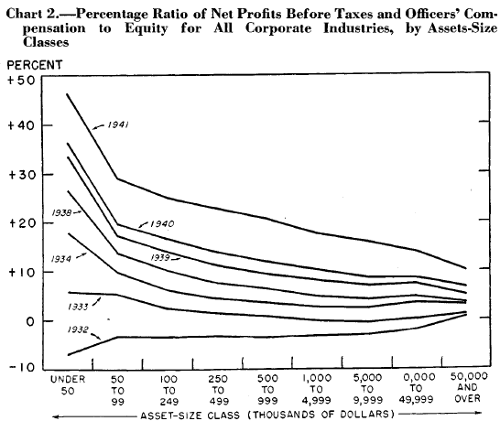
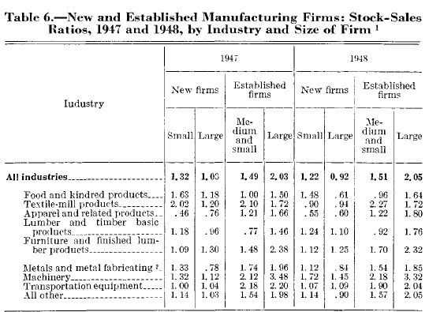
Previous BEA Estimates by Business Size
BEA and its predecessor periodically published economic statistics by business size in the 1940s-1970s
Business size categorized by different variables:
Assets
Sales
Investments
Top: McConnell, J. L. (1945). Corporate Earnings by Size of Firm. Survey of Current Business, 25(5), 6–12. Bottom: Bridge, L., and Holmes, L. E. (1950). Sales and Investment Trends of New Manufacturing Firms. Survey of Current Business, 30, 19-–23.

Slide 16
Next Steps for BEA
Developing revenue-based small business statistics using public IRS data
Census demonstration project to potentially add annual revenue to SUSB
Pursuing access to microdata
BEA is committed to developing economic statistics by business size subject to funding and data constraints
Contact: Tina.Highfill@bea.gov

Slide 17
Discussion Questions
Should BEA pursue definitions using both employment and revenue? What are advantages of having multiple definitions?
What employment and/or revenue values should BEA use to classify businesses by size?
Are enterprise-level statistics preferable to establishment-level? If so, why?
What statistics are most important for BEA to focus on?

