Slide 1
Outdoor Recreation Satellite Account:
National and State Statistics 2012-2019
Dirk van Duym
Regional Accounts

Slide 2
Main Updates to National Statistics
New with this Release
Revised estimates for 2014-2017
New estimates for 2018-2019
Revisions Reflect
Revised data from BEA’s Travel and Tourism Satellite Account
Updated expenditure data from select government agencies
Incorporation of latest National and Industry Annual Update results

Slide 3
National Level Results
Outdoor recreation nominal value added as a share of total GDP:
  2.1% in 2019
  Unrevised at 2.2% for previous periods
Outdoor Recreation Compared to Nominal GDP ($ Billions)
 |  | 2014 | 2015 | 2016 | 2017 | 2018 | 2019
U.S. GDP (Nominal Value Added) |  | 17,527.3 | 18,238.3 | 18,745.1 | 19,543.0 | 20,611.9 | 21,433.2
ORSA GDP (Nominal Value Added) |  | 378.3 | 399.2 | 406.0 | 425.2 | 443.3 | 459.8
ORSA GDP as a Percentage of U.S. Total |  | 2.2 | 2.2 | 2.2 | 2.2 | 2.2 | 2.1
ORSA | Real Gross Output | 707.3 | 728.2 | 739.5 | 759.6 | 776.8 | 787.6
 | Real GDP | 362.7 | 371.2 | 372.5 | 387.2 | 397.6 | 402.8
 | Employment (Thousands) | 4,852.3 | 4,938.1 | 5,050.0 | 5,112.1 | 5,150.0 | 5,168.5
 | Compensation | 186.3 | 193.3 | 200.3 | 209.4 | 217.8 | 226.3

Slide 4
National Level Results (2019)

Slide 5
National Level Results (2019)

Slide 6
State ORSA
New Estimates (2018-2019)
Revised Estimates (2012-2017)

Slide 7
Geography of Outdoor Recreation
Measured by place of production,
not residence of consumer
  Goods: Geography represents the location where a product is produced
  Services: Geography represents the location where a service is provided, including retail services

Slide 8
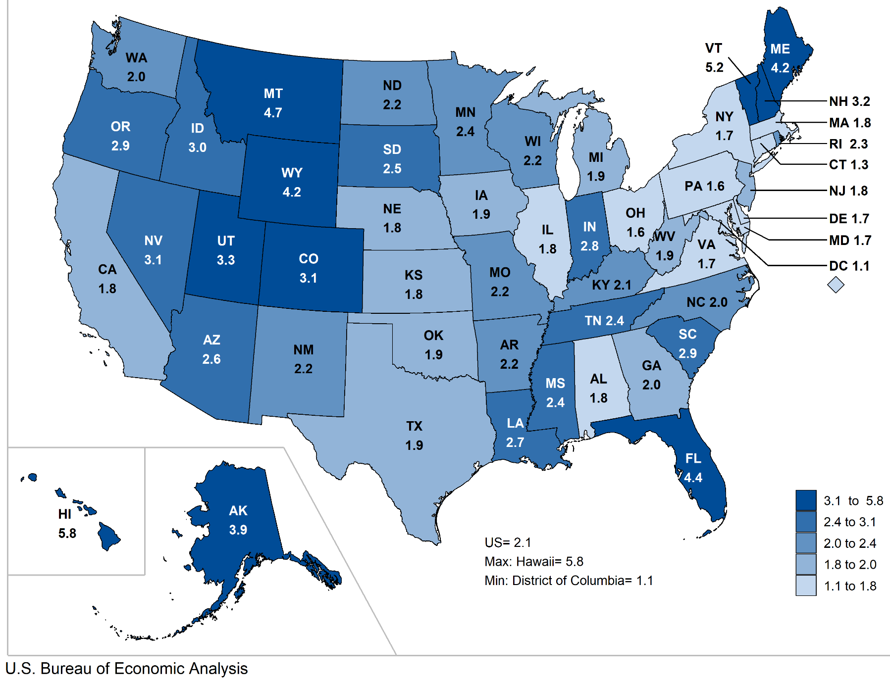
ORSA VA Share of State VA

Slide 9
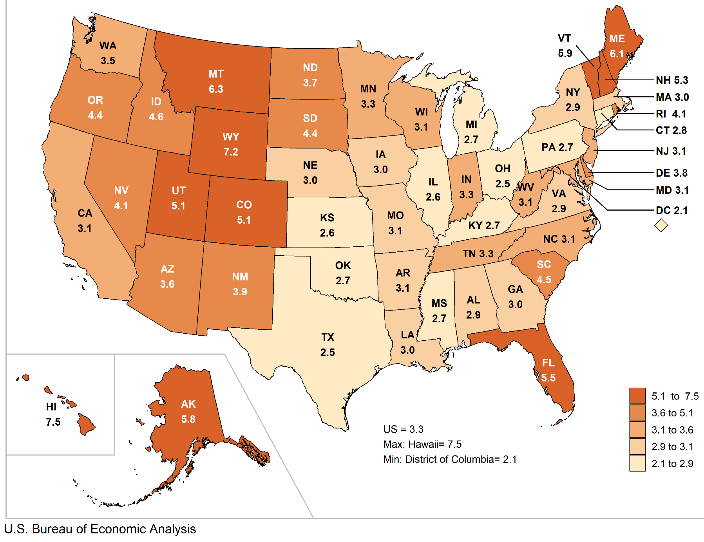
ORSA Jobs Share of State Jobs
Note: Jobs share is ORSA jobs as a share of state wage-and-salary jobs.

Slide 10
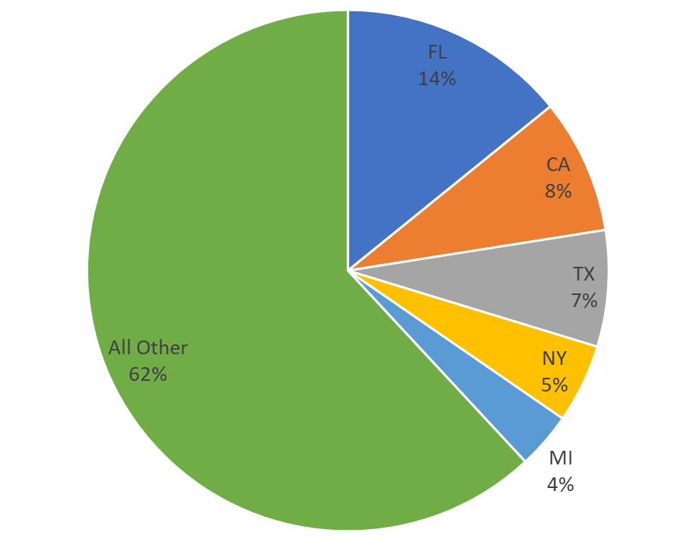
Boating/Fishing Value Added, 2019

Slide 11
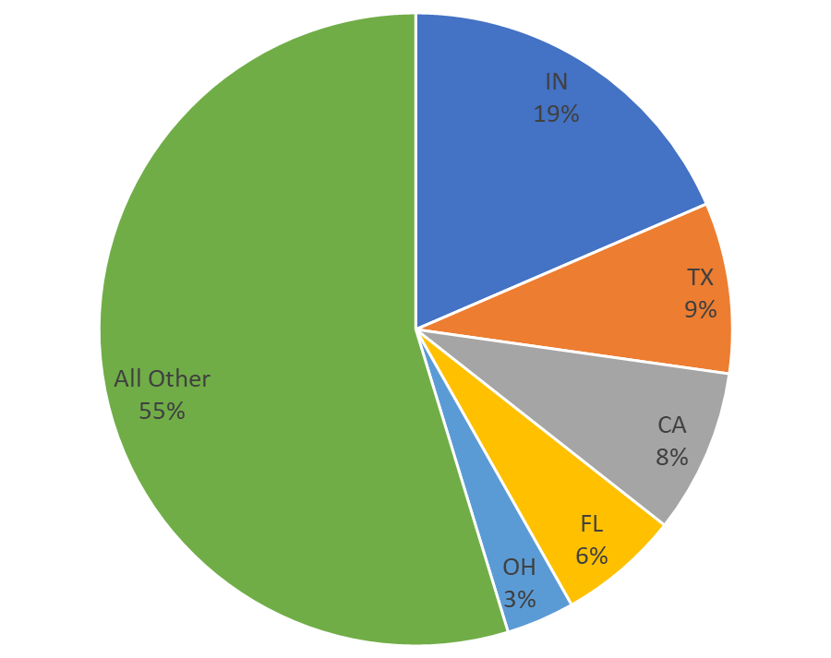
RVing Value Added, 2019

Slide 12
Questions?
Dirk van Duym
OutdoorRecreation@bea.gov
301-278-9003

