Slide 1
Outdoor Recreation Satellite Account: National and State Statistics 2012-2020 Outdoor Recreation Roundtable Briefing
Dirk van Duym

Slide 2
Main Updates to ORSA Data
New data for 2020
Revised data for 2012-2019
Incorporation of BEA’s annual update
Updated data sources, including:
Government budget data from other federal agencies
National Marine Manufacturers Association, American Horse Council, National Shooting Sports Foundation, other private data sources

Slide 3
Topline U.S. Data, 2020
Value Added: $374 billion
1.8 percent of U.S. GDP
Gross Output: $689 billion
Employment: 4.3 million jobs
Compensation: $203 billion

Slide 4
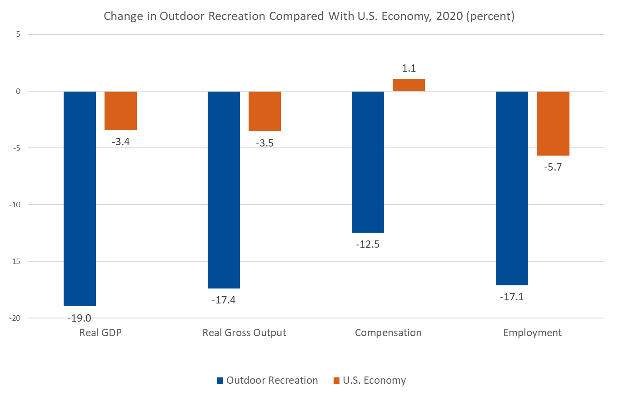
National Level Results, 2020

Slide 5
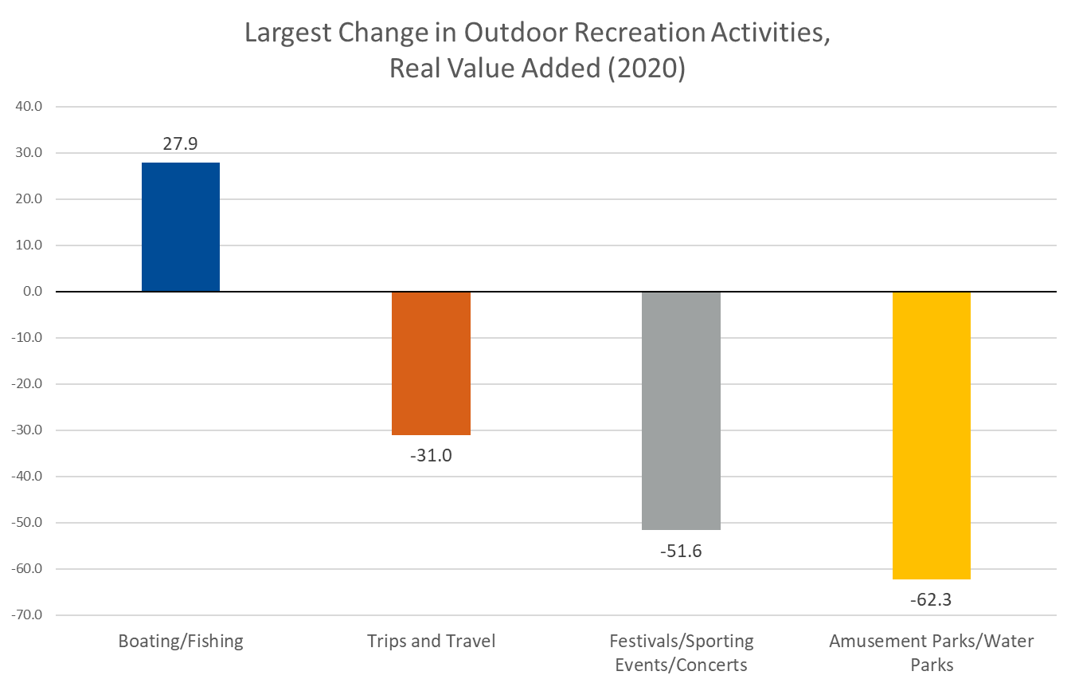
National Level Results, 2020

Slide 6
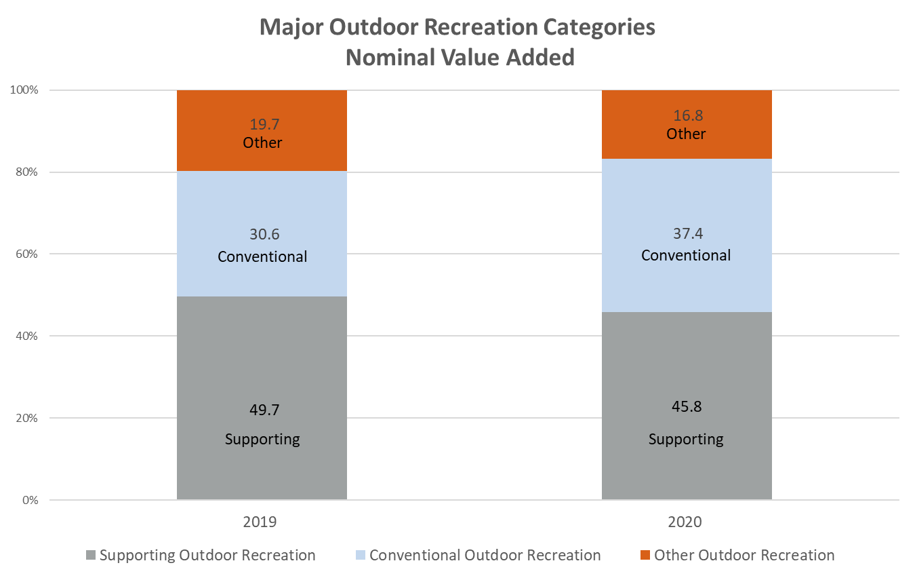
National Level Results, 2020

Slide 7
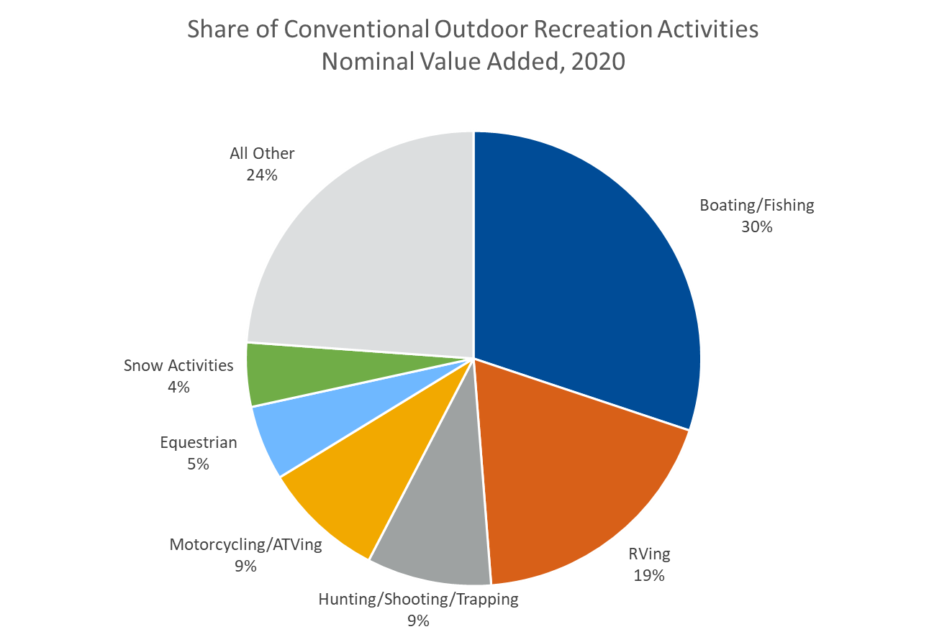
National Level Results, 2020

Slide 8
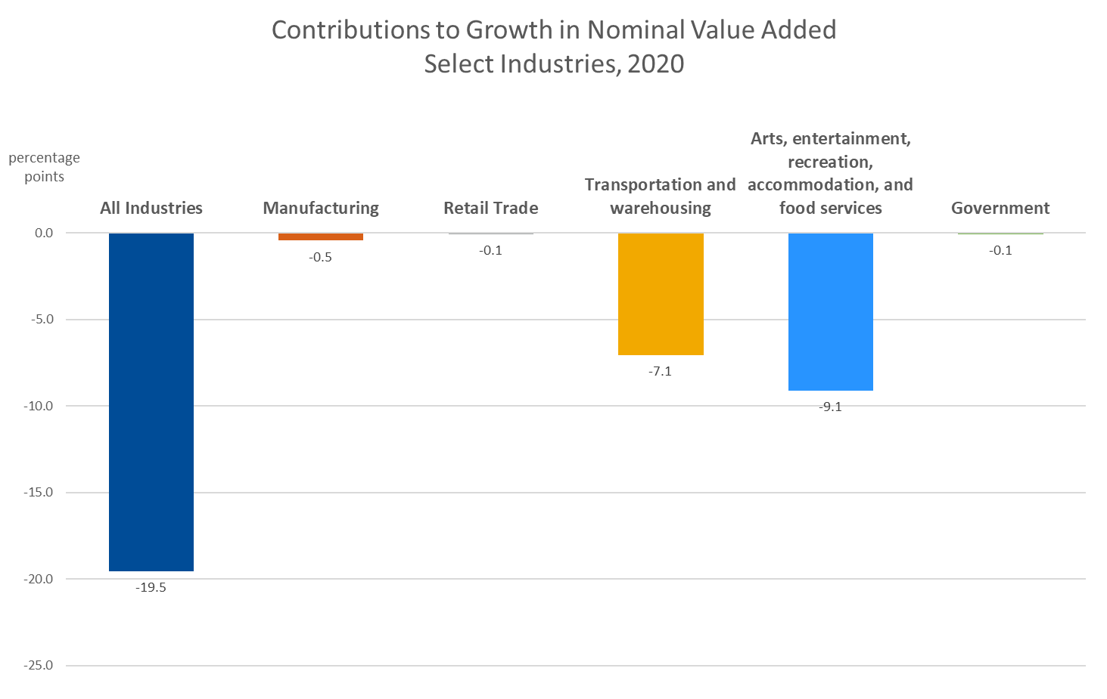
National Level Results, 2020

Slide 9
Geography of Outdoor Recreation
Measured by place of production,
not residence of consumer
Goods: Geography represents the location where a product is produced
Services: Geography represents the location where a service is provided, including retail services

Slide 10
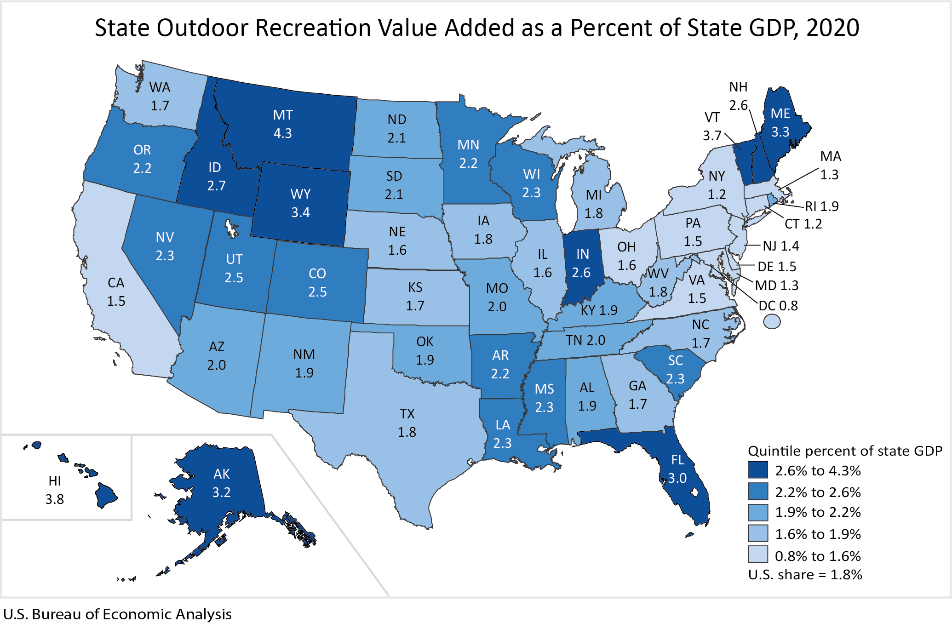
Value Added

Slide 11
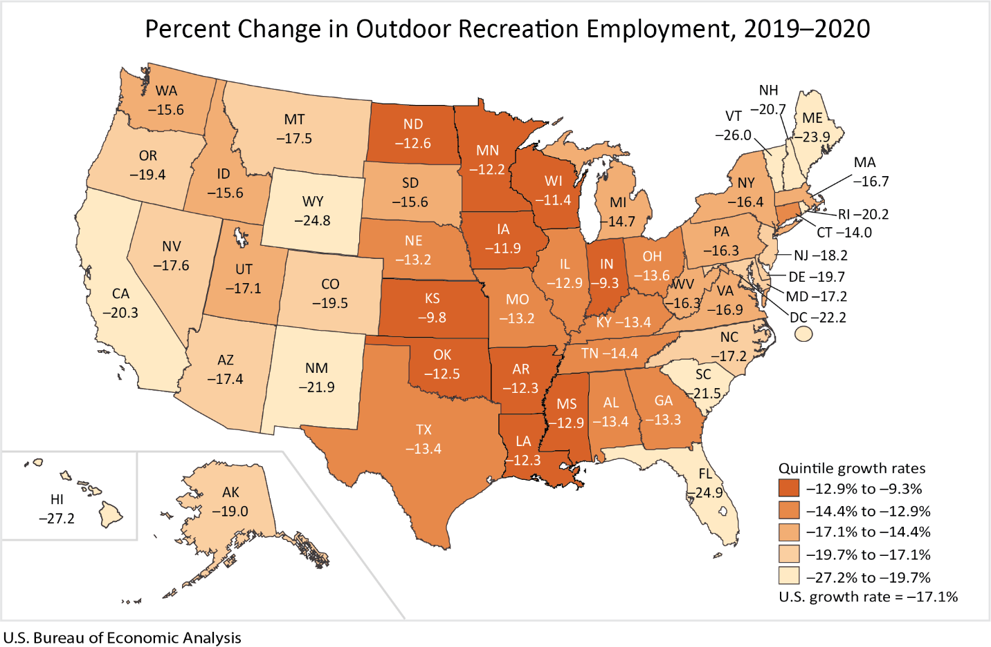
Employment Percent Change

Slide 12
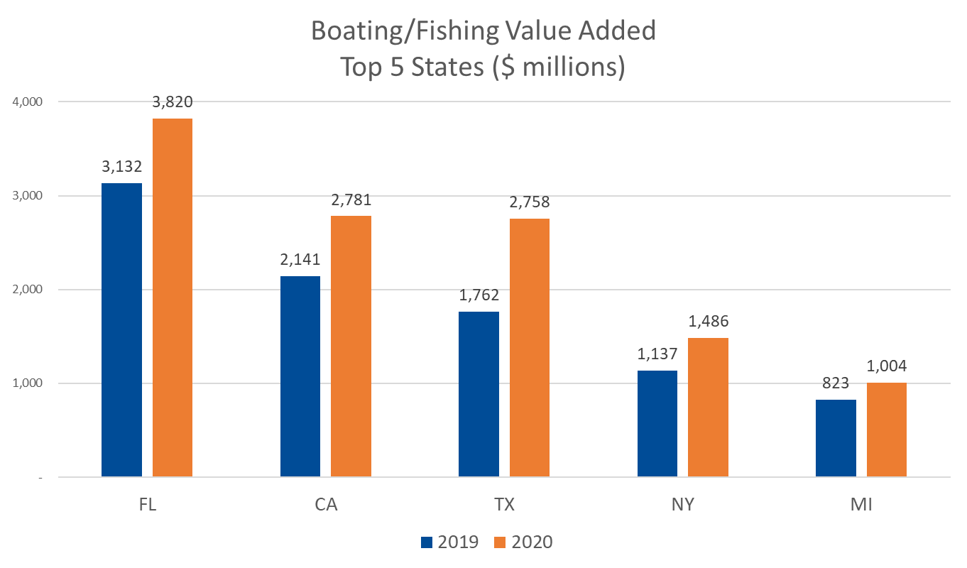
Value Added by Activity: Boating/Fishing

Slide 13
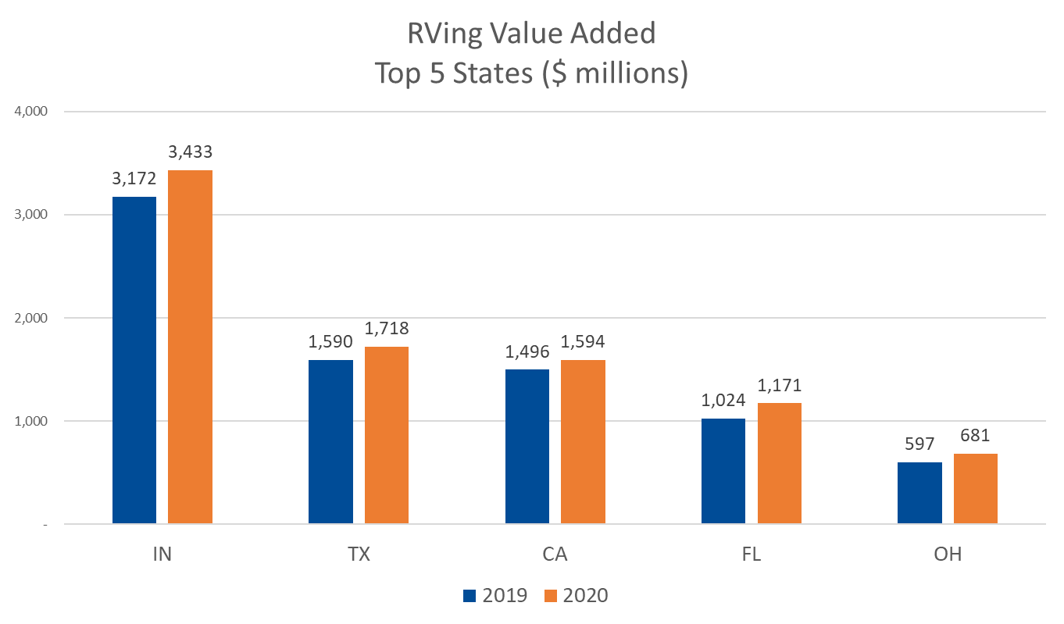
Value Added by Activity: RVing

Slide 14
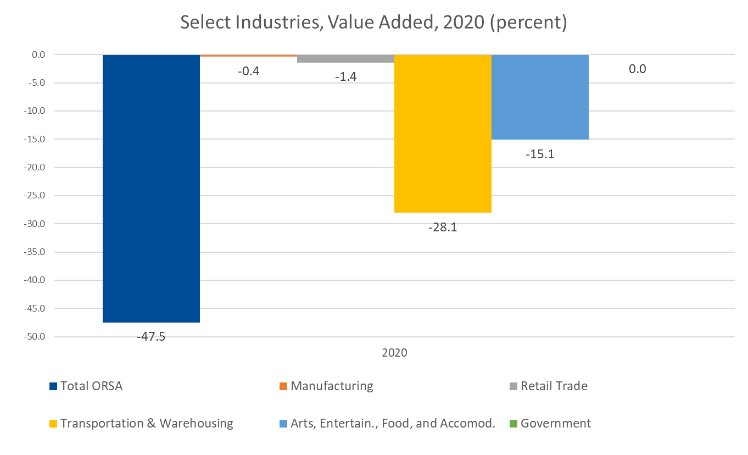
Hawaii Contributions to 2020 Decline, by Industry

Slide 15
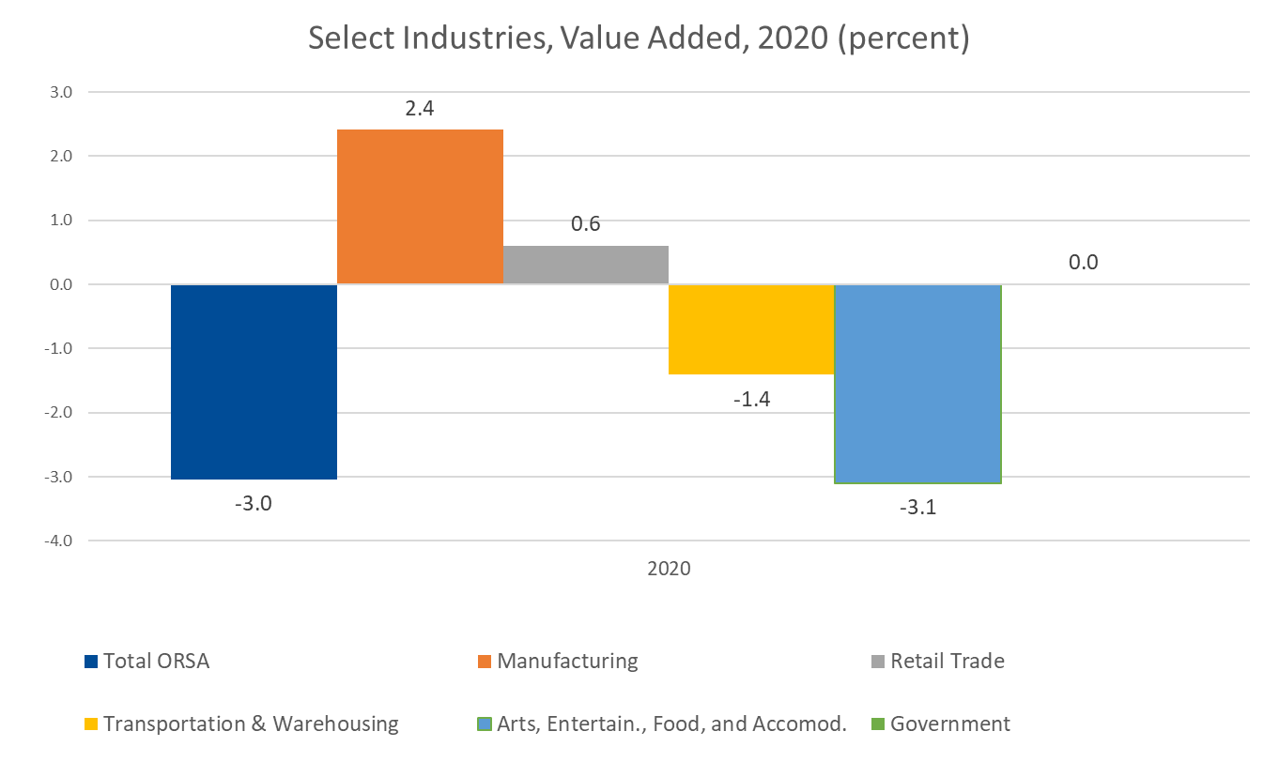
Indiana Contributions to 2020 Decline, by Industry

Slide 16
Contact Information
Questions?
OutdoorRecreation@bea.gov
(301) 278-9003

